Slide 1
Machine Learning on a Raspberry Pi
Linda MacPhee-Cobb
https://github.com/timestocome
Notes:
Introduce self, background, interests
Please interrupt, ask questions….

Slide 2
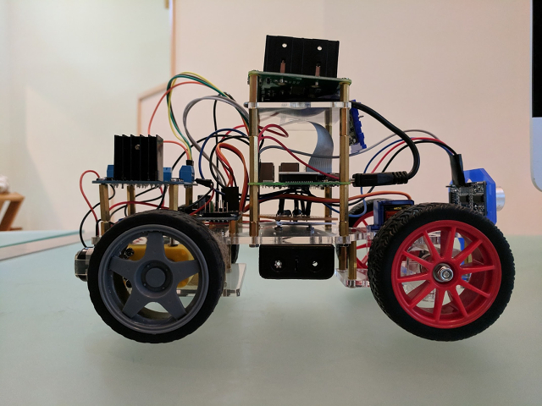
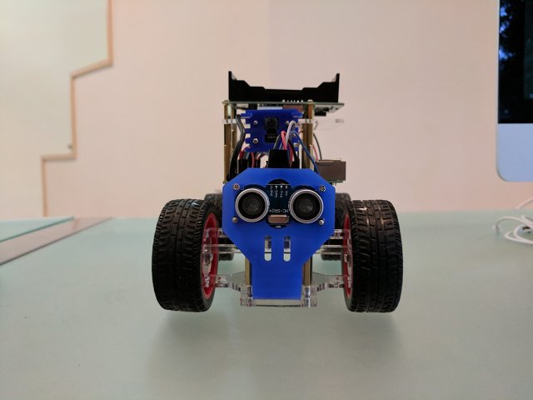
Mobile Robots
Sensors: UltraSonic distance sensor, Camera
Trained using Google’s TF Mobile Models
Obstacle avoidance with simple RL
Output: Wheel movement f/r, turn servo to steer, LED lights if either cat is spotted
Notes:
Robot kits available Frye’s, eBay, Amazon
More expensive ones require less soldering and have better directions
MicroCenter and EPO also have lots of parts

Slide 3
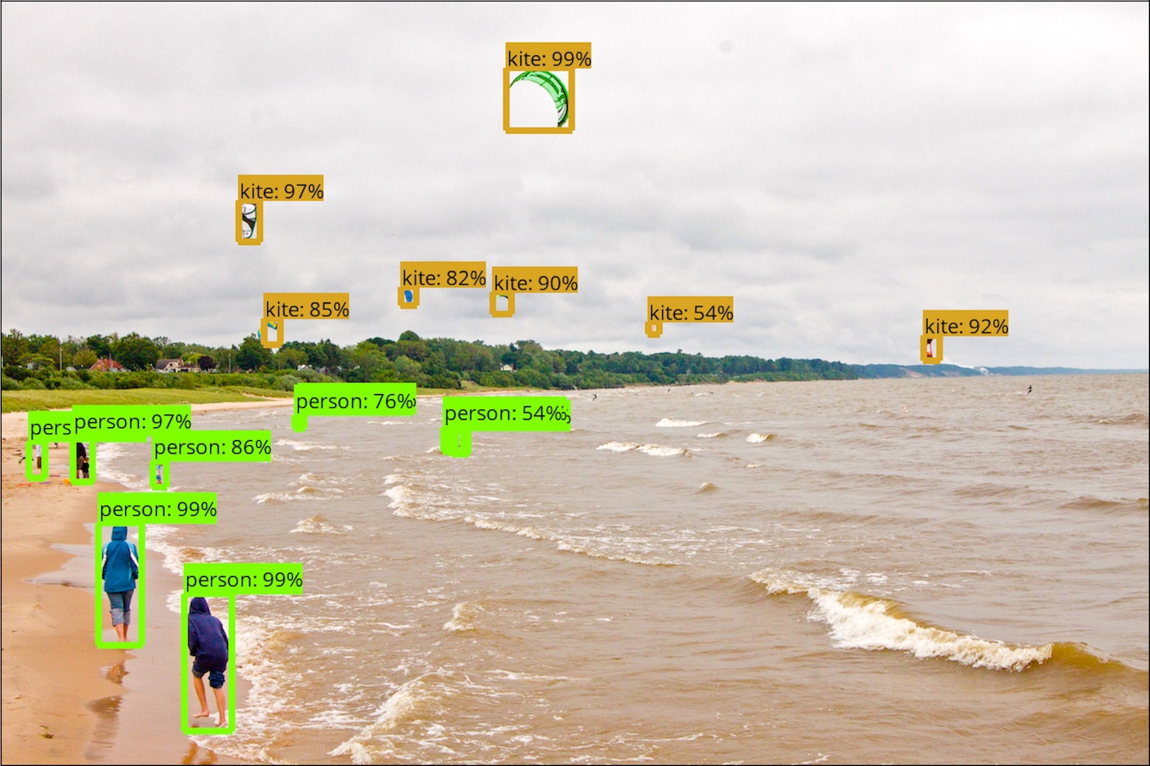
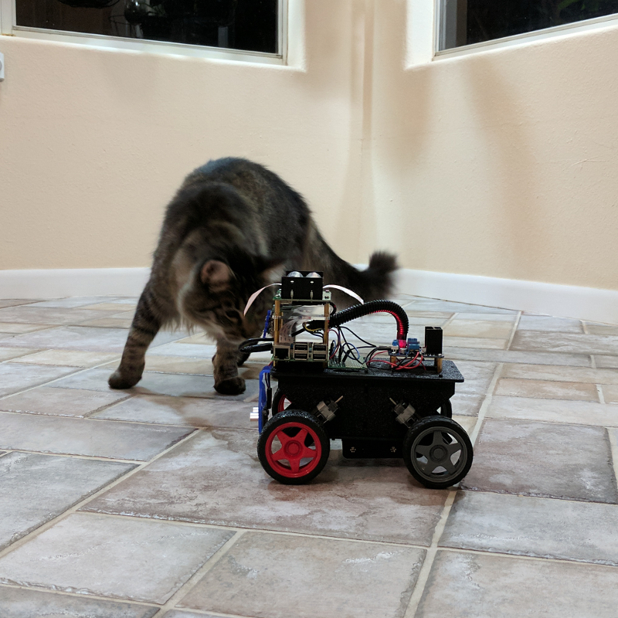
Image classification
Out of the box Google Mobile Network recognizes many objects ~ 10secs/frame
Re-trained on smaller sets ( both cats ) runs ~ 2 frames/second
~100 images each category, 3 categories (Min, Merlin, No cat)
~30 mins on desktop, copy trained network onto Pi
* when you retrain it the built in classifications are forgotten
Notes:
Google has made TF and several pre-trained models available for mobile devices and SBC
Re-train on your desktop, drop model on to Pi after training
Simple models are very fast, slow ones still good for package on porch, dog on couch, garage door open
Open CV is also available for Raspberry Pi

Slide 4
Using Tensorflow on a Pi
Change the default system Python to 3.5
Follow the directions on
https://github.com/samjabrahams/tensorflow-on-raspberry-pi/
* Change the name of the wheel file to cp35-cp35m from cp34-cp34
Step by step detailed directions on
https://github.com/timestocome/RaspberryPi-Robot

Slide 5
Building an object detector
Download and install TensorFlow models
https://github.com/tensorflow/models
Install and Test the model
https://github.com/tensorflow/models/tree/master/research/object_detection
Take and image and try it out
https://github.com/timestocome/RaspberryPi-Robot/tree/master/ObjectDetection

Slide 6
Build a grey cat orange cat detector
You’ll need Python and TF installed on your desktop
Collect images ( ~100 orange cat, ~100 grey cat, ~ 100 not a cat )
Put orange cat images, grey cat, not a cat images into 3 different directories
Try different models, you’l be trading speed and accuracy
copy the saved model to your Pi
Test
Detailed directions and help
https://github.com/timestocome/RaspberryPi-Robot/tree/master/catID

Slide 7
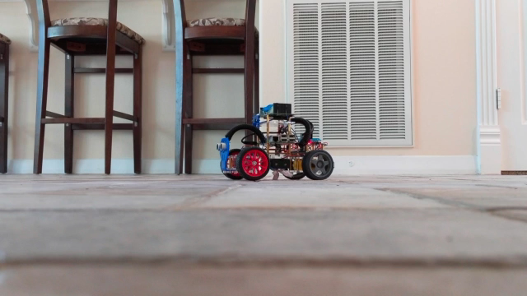
Self teaching
Using a small state space and one objective RL is easy
Multiple objectives is mostly unsolved
Notes:
Wheels are deliberately pulsed after first robot beheaded itself under couch and was then finished off by Merlin
Robot is sensing me in it’s way and adjusting
Proto type, robot relearns every time I start it, not currently saving data
Sensor data comes in fast, code must be lean

Slide 8
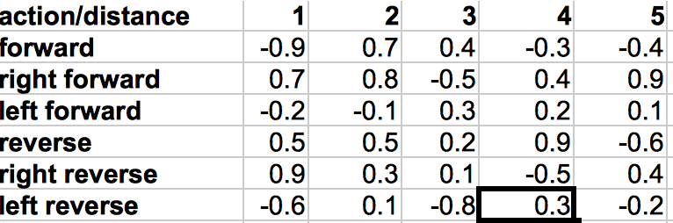
Simple Reinforcement Learning
Everything done on the Pi has to be lean.
It’ll be taking sensor data at high speeds and in large amounts if you’re using video
Start with random values
Every time the sensor data comes back into the range in your matrices
select the action with the highest value. If things get better increase that value, else decrease it

Slide 9
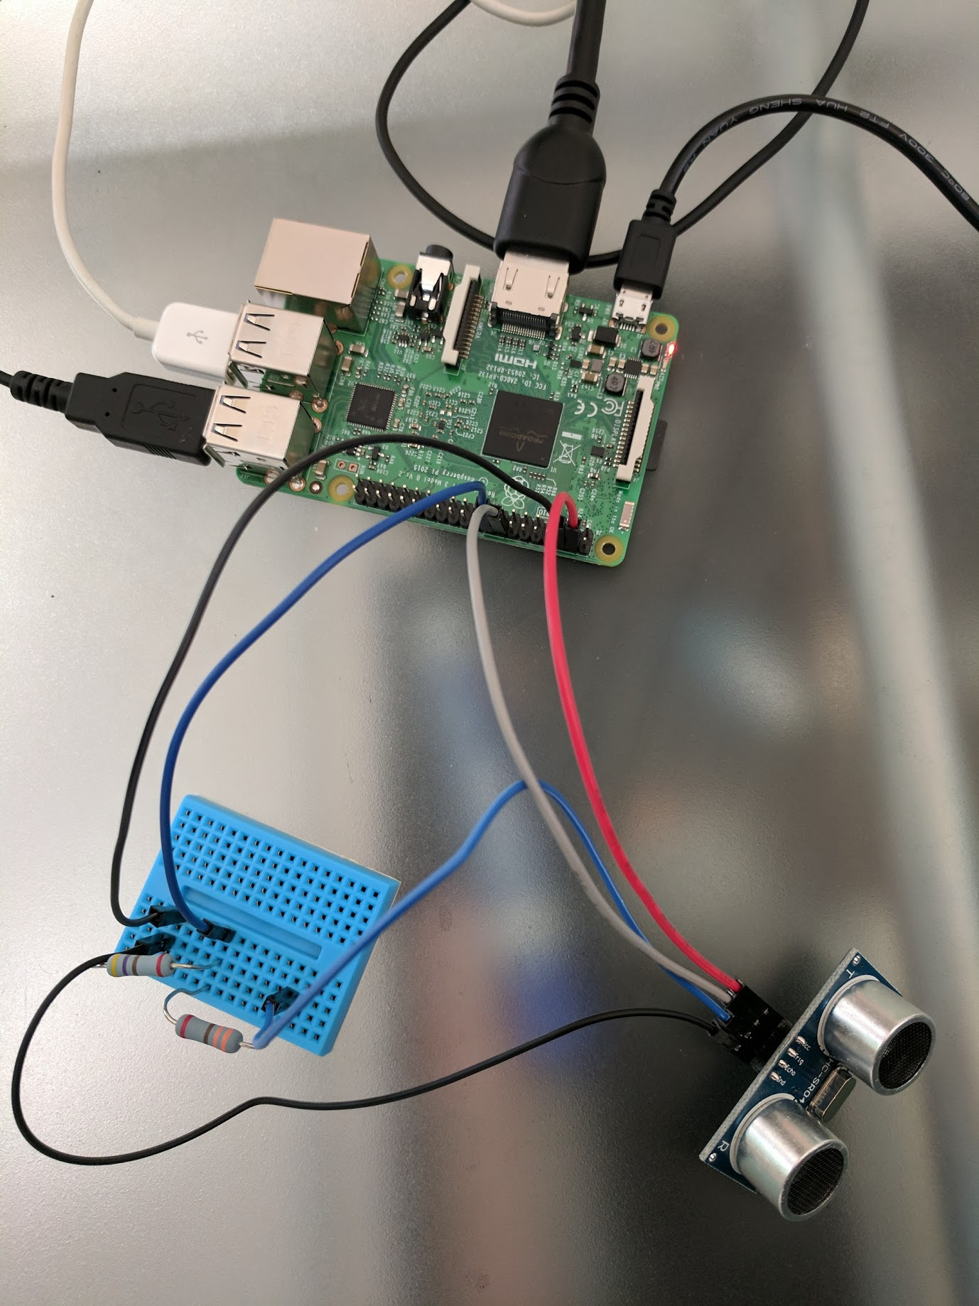
UltraSonic Distance Sensor
AI and ML Robotics Group ( Stanford ) trained several robots to map rooms
using SLAM
Bumped into a RE Agent at EPO who was using these sensors to create floor plans
by following walls
Car robot learns obstacle avoidance in about 100-1000 time steps, trick is to use
a small state space matrix (actions, distance)
Notes:
SR204 UltraSonic distance sensor
sends ultra sonic pulse out, gets reflected signal back at speed of sound ~344 m/s 15’-1”
know the limits of your sensor
check spec sheets, incoming data may need manipulation ( temp/humidity )

Slide 10
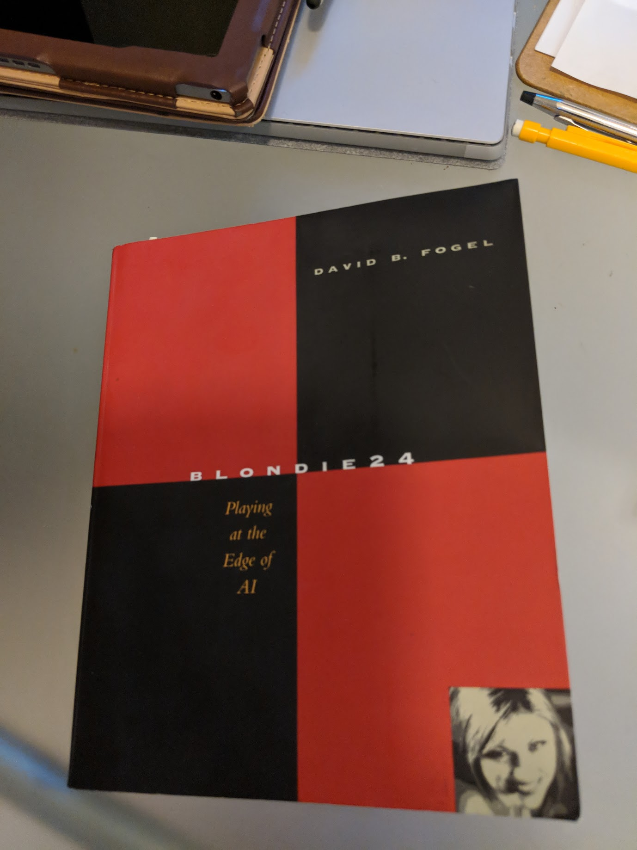
Artificial Intelligence
Before AlphaGo there was Blondie24
Everything AlphaGo does is in this book and
a few things it doesn’t yet do
Blondie24 played world class checkers on
mid 1990s computers that were no more
powerful than a Raspberry Pi
Notes:
Blondie used all the Google Brain techniques: Markov tree search, neural networks, self play, also used evolutionary computing which is coming back into use
Very readable book, highly recommend

Slide 11
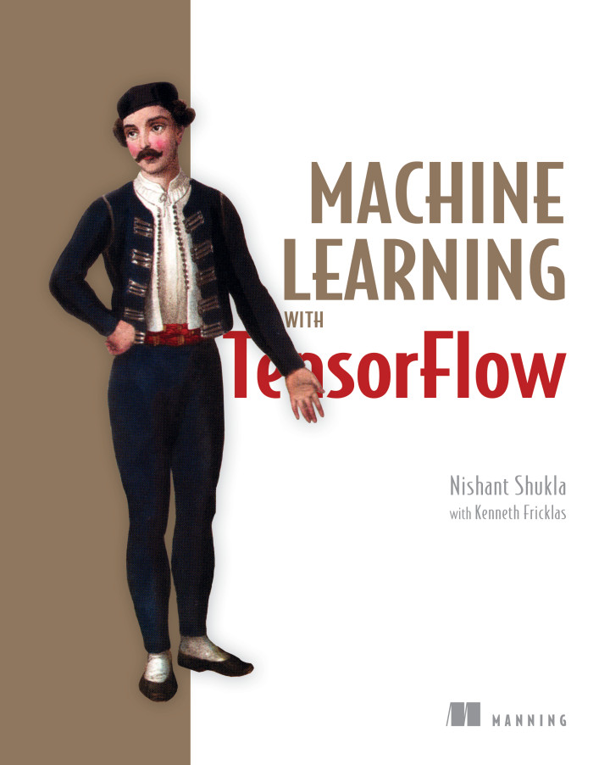
Tensorflow Resources
Tensorflow for Poets
https://codelabs.developers.google.com/codelabs/tensorflow-for-poets/#0

